Slide 1
Arrays in Java Lecture - 11
Prepared By - Rupali Patil

Slide 2
Contents
java.util.Arrays class
String class
String buffer
String builder

Slide 3
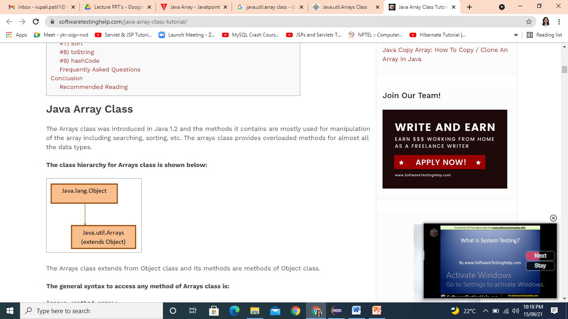
java.util.Arrays class
Arrays class is member of java.util package.
This is part of java collection framework.
It provides methods to create, access and manipulate java arrays dynamically.
All methods provided by the Arrays class are static in nature and are methods of the ‘Object’ class.
As the methods are static, they can be accessed using the class name

Slide 4
Strings class
Java library contains a predefined class called as String.
The String type is not a primitive type.
String class represents an ‘immutable’ strings.
Once an instance is created, the string it contains cannot be changed.
To change the string referenced by a string variable, you throw away the old string and replace it with the modified one.
E.g String s = “Hello”;

Slide 5
Strings contd..
We can change reference of strings.
We cannot change value of the string.
Strings created using literals are stored in String Constant pool in heap(SCP).
Garbage collector is not allowed in SCP.

Slide 6
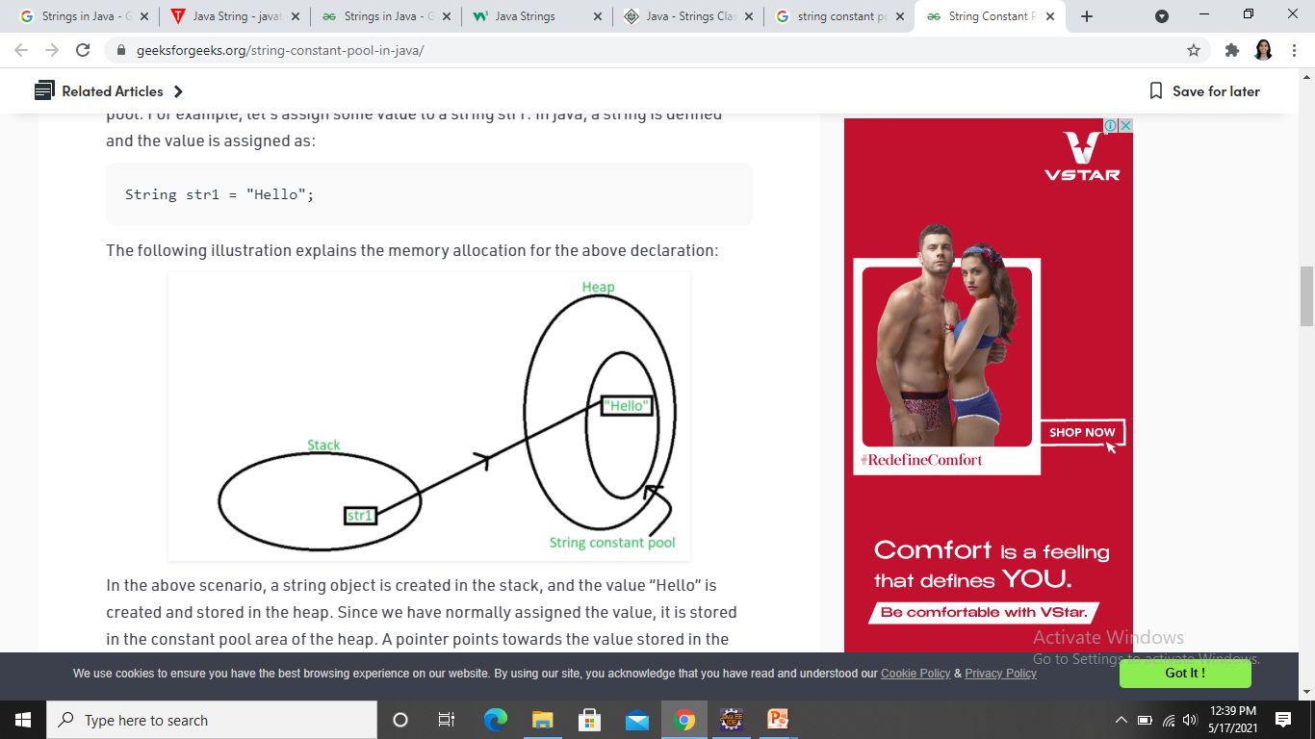
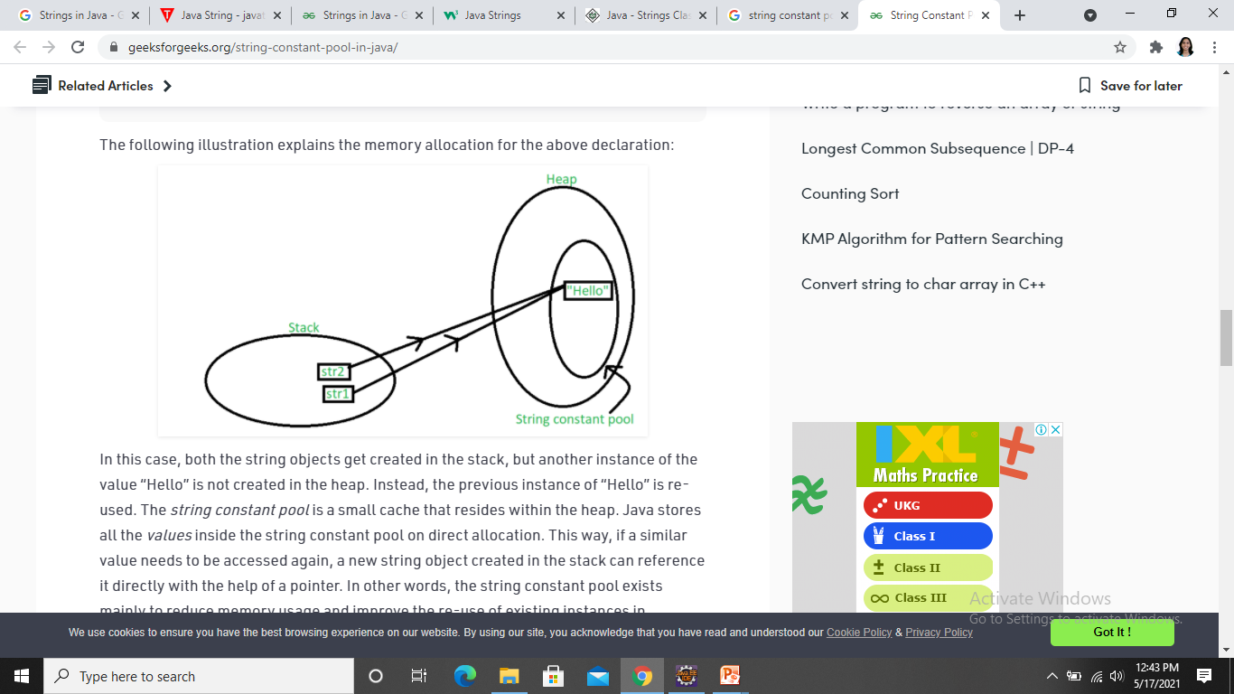
String Representation in memory
String str1 = "Hello";
String str2 = "Hello";

Slide 7
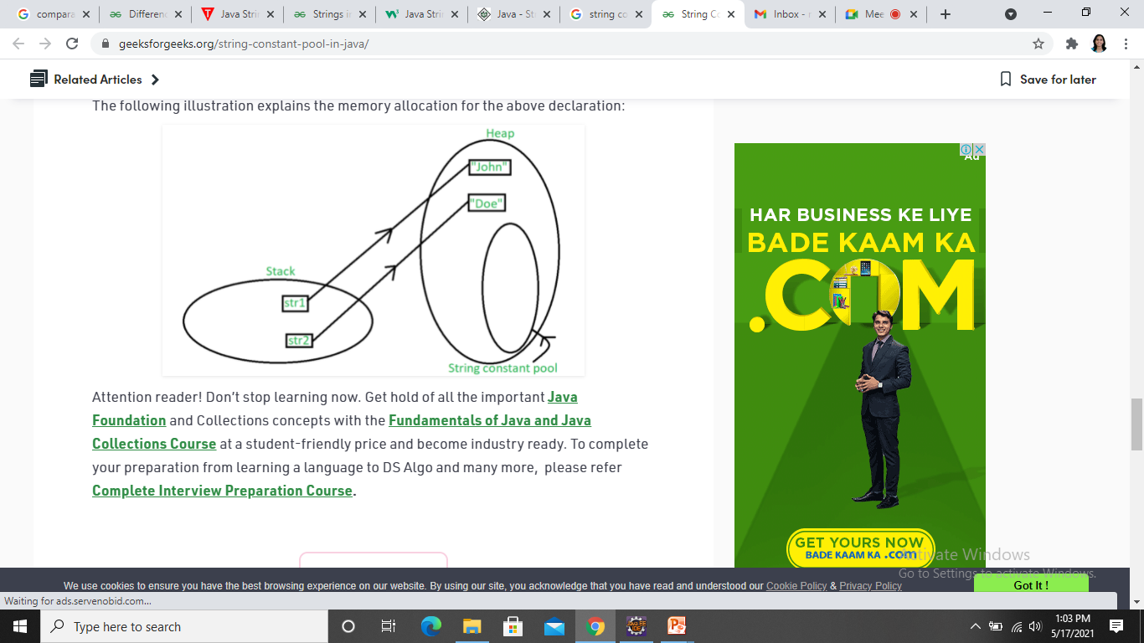
String Representation in memory
String str1 = new String(“John”);
String str2 = new String(“Doe”);

Slide 8
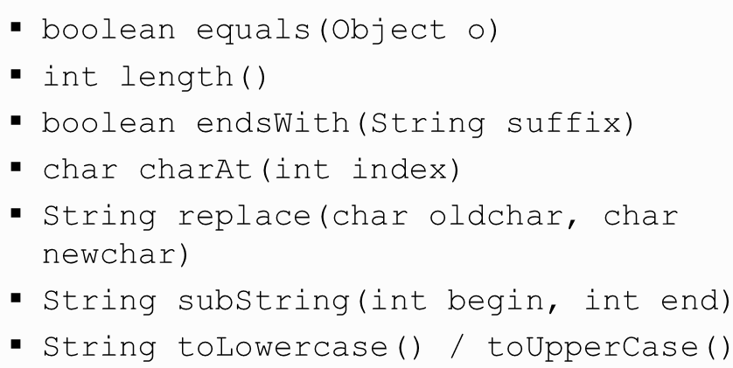
String Operations

Slide 9
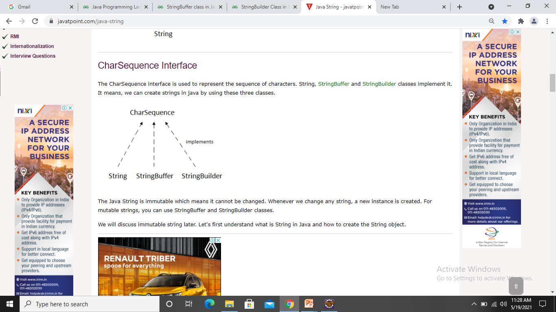
CharSequence Interface
CharSequence interface is used to represent sequence of characters.
String, StringBuffer and StringBuilder classes implement it.

Slide 10
String Buffer
StringBuffer class allows to create mutable strings.
It pre-allocates memory of given length.
Buffer grows automatically as characters are added.
E.g StringBuffer sb = new StringBuffer();
String Buffer are safe for use by multiple threads.
All methods are synchronized.
Slower as compared to StringBuilder.

Slide 11
String Builder
StringBuilder is a class which represents sequence of characters.
It is similar to the StringBuffer.
StringBuilder is not thread safe.
Advantage of StringBuilder is faster performance.
In case of multithreading, one must use the StringBuffer rather than StringBuilder.

Slide 12
Thank You

